Slide 1



UNIT 4
LESSON 16
What if…?
Part 3

Slide 2

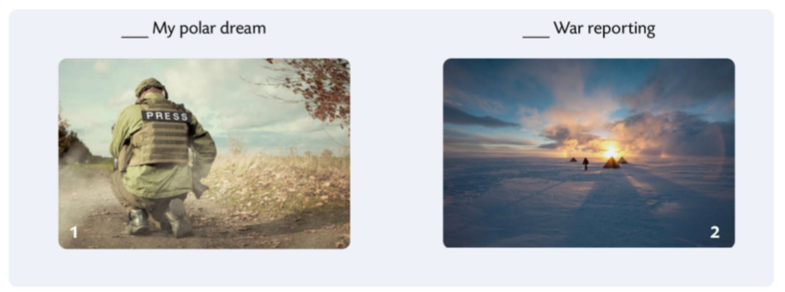
2
1

Slide 3
public opinion
the opinion that people in society have about an issue
javno mišljenje
hat-trick
three successes achieved by one person
tri uzastopna uspjeha
crew
a group of people who work together, especially all those who work on and operate a ship, aircraft, etc.
momčad, posada, društvo
credibility
the quality that somebody/something has that makes people believe or trust them
vjerodostojnost
equipment
the things that are needed for a particular purpose or activity
oprema, pribor
ice cap
a layer of ice permanently covering parts of the earth, especially around the North and South Poles
polarni ledeni vrh
lucky charm
an object that is believed to bring its owner good luck
amajlija, talisman
persistence
the fact of continuing to try to do something despite difficulties, especially when other people are against you and think that you are being annoying or unreasonable
upornost

Slide 4
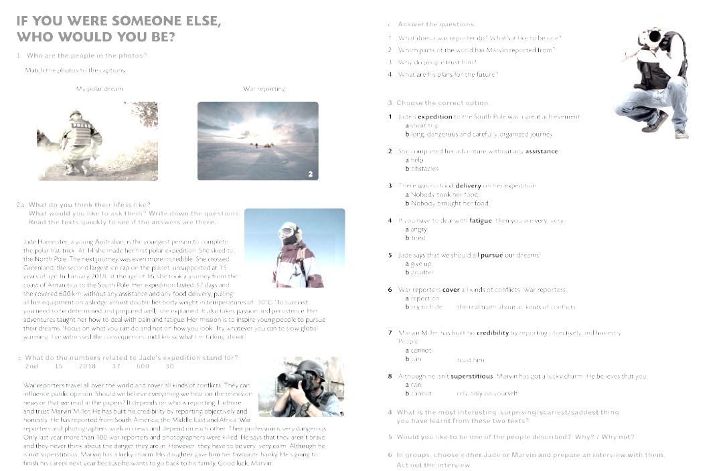
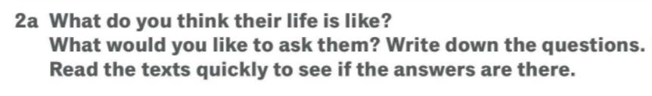
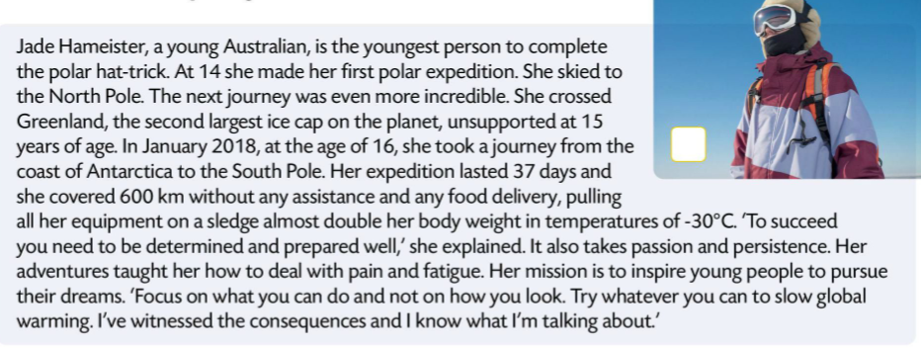
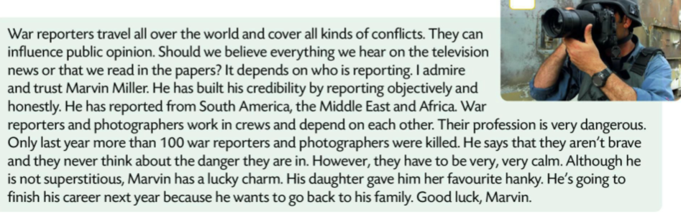
Report on your answers.

Slide 5

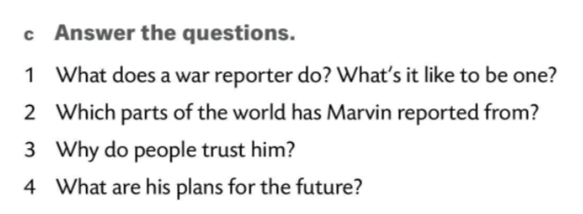
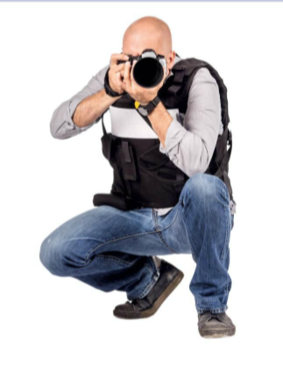
v
The ice cap Jade crossed is the 2nd largest ice cap on the planet.
She was only 15 when she did it.
In 2018, when she was 16, Jade took a journey from the coast of Antarctica to the South Pole.
This expedition lasted 37 days.
In this expedition, she covered 600 km.
She undertook the expedition in temperatures of -30°C.
1 A war reporter travels all over the world and covers all kinds of conflicts. It’s a very dangerous but exciting job.
2 South America, the Middle East and Africa.
3 Because he reports objectively and honestly.
4 He’s going to finish his career next year.

Slide 6
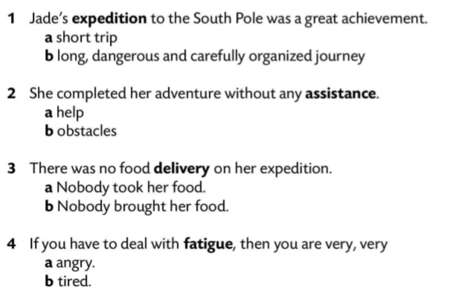
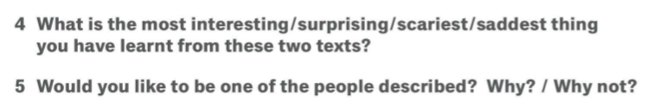
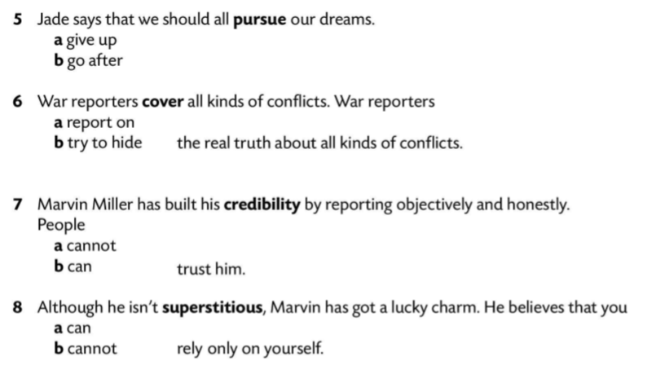

Have a discussion based on task 4 and task 5.

Slide 7

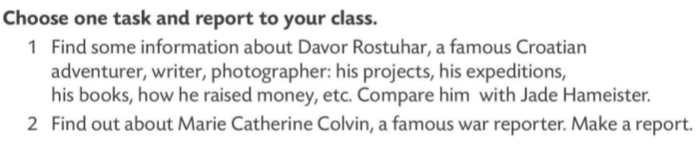
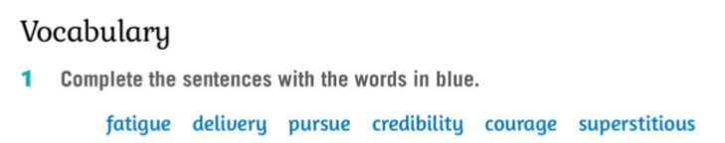
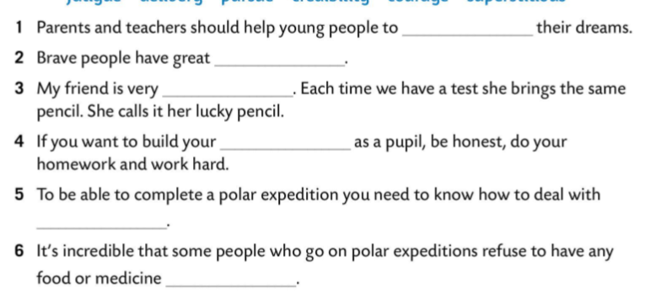

pursue
courage
superstitious
credibility
fatigue
delivery

